Slide 1
CODIFICATION – HIDDEN REALITY
CODES/MATRIX COMBINED WITH MENTAL HEALTH WITHIN THE POLICE FORCE

Slide 2
What is the brand about?
I wanted to combine computer coding/circuits with mental health within the police force as it isn’t really a well known topic to be discussed about on the news or just in general. So my aim is to showcase the reality of police officers dealing with mental health problems but showing this within a coding style to show the hidden statistics.

Slide 3
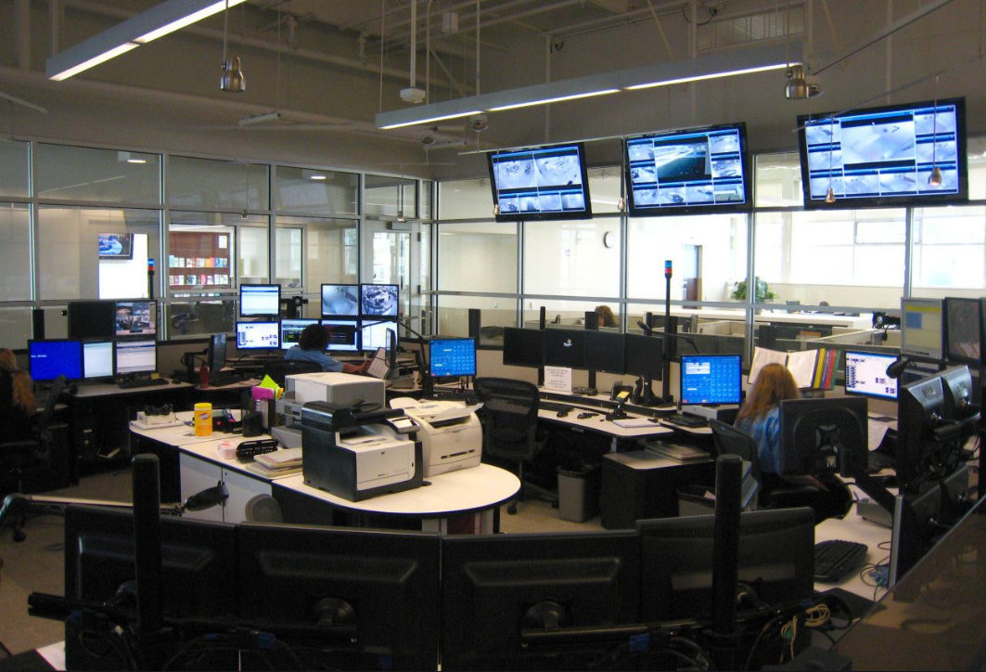
EXHIBITION SPACE
POLICE STATION
FBI BUILDING

Slide 4




LOGO IDEAS
Tried different variations of the logo, using different weights and colour theories, also trying out different textures.

Slide 5
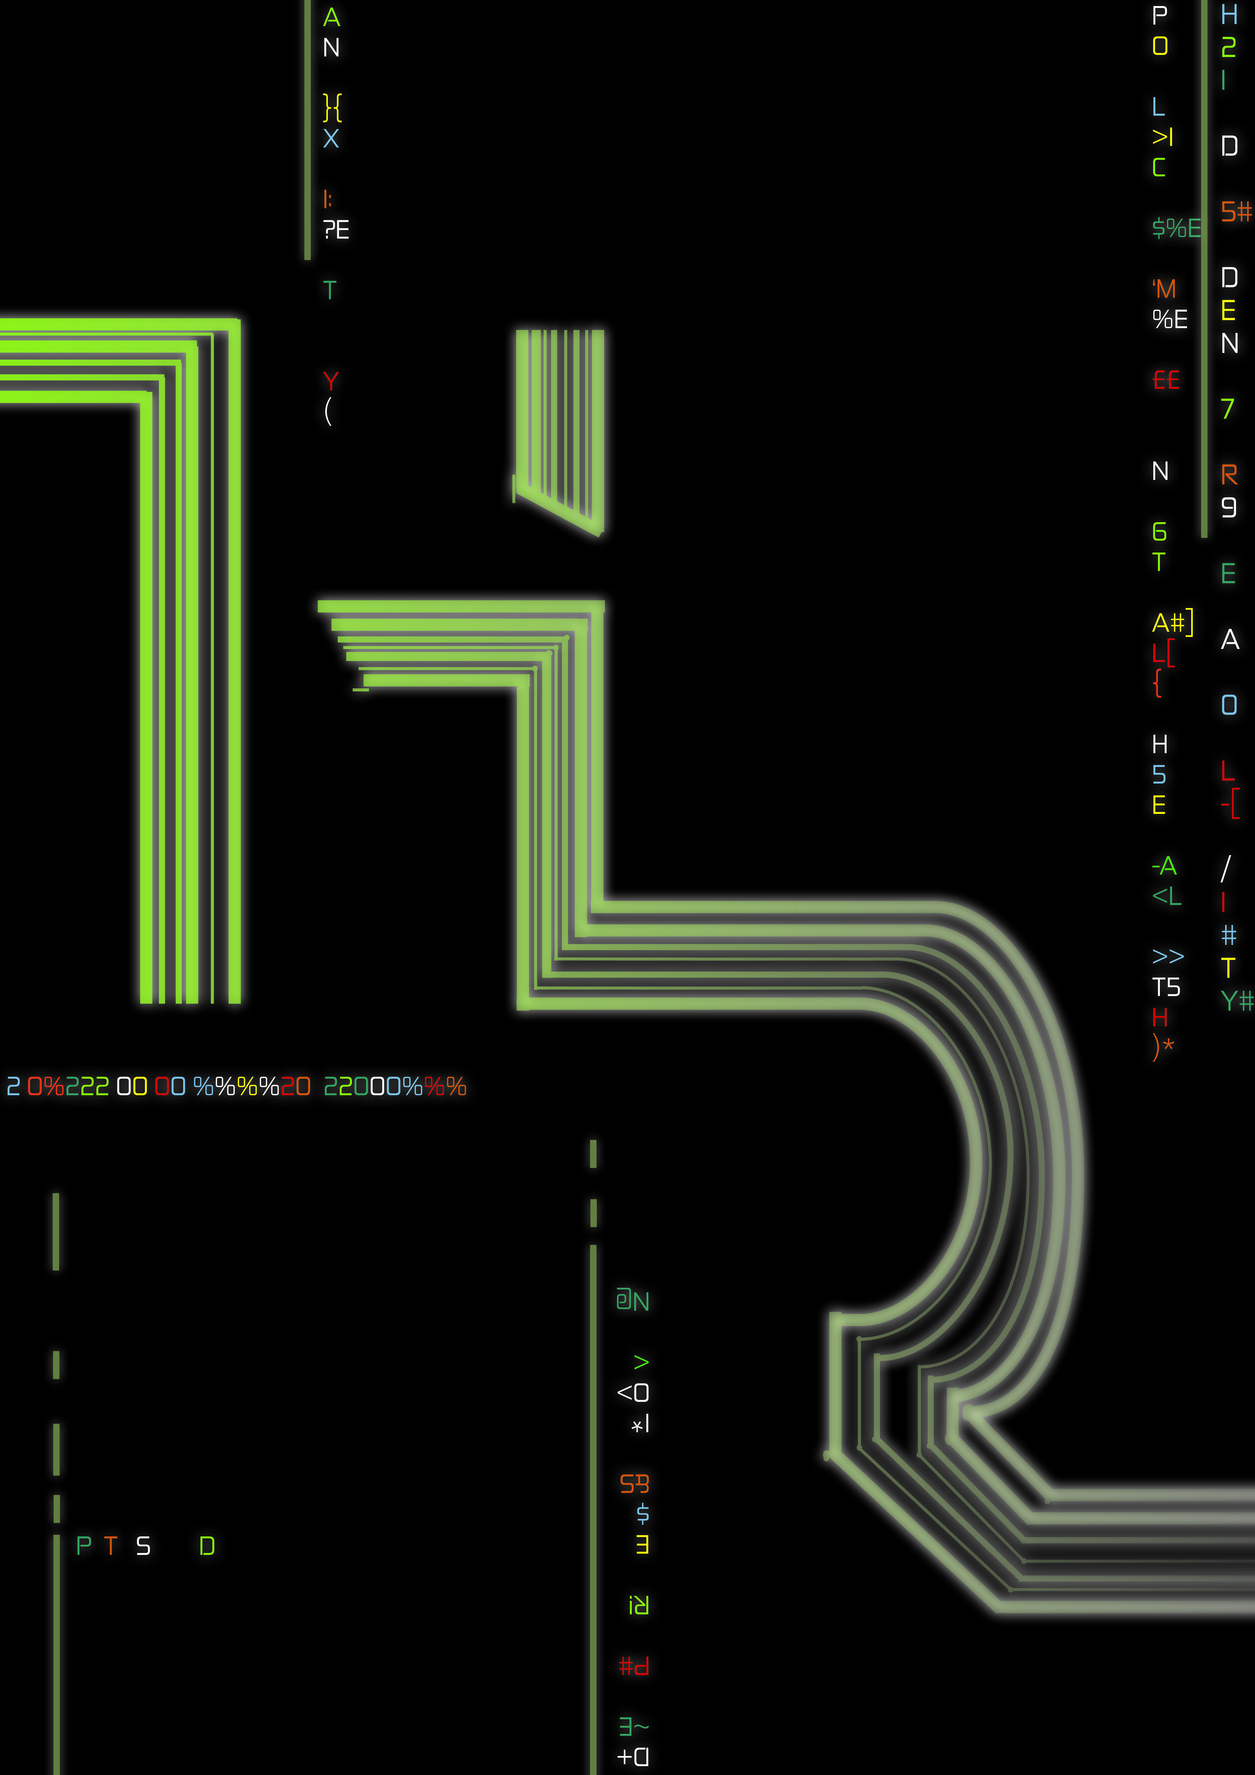
Poster Ideas
Using the matrix rain to put hidden messages on the poster.
Used circuit like design to create the logo to relate to computer coding.

